Slide 1
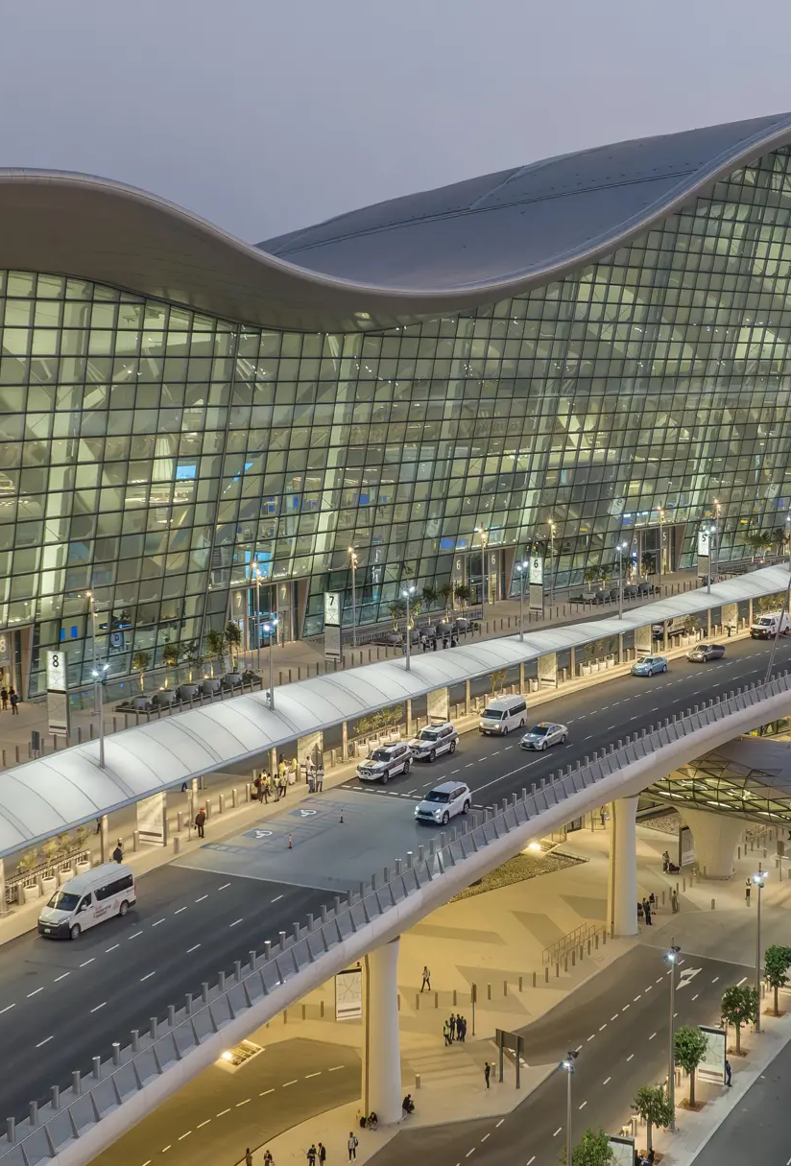

Smart Showcase Project Concept
LAB TO MARKET

Slide 2
Agenda
01 | Vending Machine Market Analysis
02 | Other product analysis, UI/UX References
03 | LAB TO MARKET’s Solutions
04 | Business Model: How to make profit?
05 | Specific Strategy: How to implement it?

Slide 3
What we have to discuss about this project are:
제품이 가지는 차별점은 무엇인가? | 기존 한국 시장은 롯데기공, 로벤 등과 같은
반품 기능을 지원할 경우 risk control 은 어떻게? | 기존과 달리 machine 에서 반품 기능을 지원할 경우 고객이 부담하는 return-fee policy 수립 및 반품 상품에 대한 freshness, cost 관리가 필요함
Add a common question that your audience might ask | Write an answer to the question your audience may ask. Make it clear and concise so the audience can quickly skim the content on your slide
Add a common question that your audience might ask | Write an answer to the question your audience may ask. Make it clear and concise so the audience can quickly skim the content on your slide
Add a common question that your audience might ask | Write an answer to the question your audience may ask. Make it clear and concise so the audience can quickly skim the content on your slide
Add a common question that your audience might ask | Write an answer to the question your audience may ask. Make it clear and concise so the audience can quickly skim the content on your slide
Add a common question that your audience might ask | Write an answer to the question your audience may ask. Make it clear and concise so the audience can quickly skim the content on your slide

Slide 4
United Arab Emitrates
Add a subtitle​
Give general information about this topic to add depth and clarity. Write short, interesting reference points that don’t need to be read aloud.​
Add a subtitle
Give general information about this topic to add depth and clarity. Write short, interesting reference points that don’t need to be read aloud.​
Add a subtitle​
Give general information about this topic to add depth and clarity. Write short, interesting reference points that don’t need to be read aloud.​

Slide 5
Timeline
Add an event
Write a description of the significance of this event
Add an event
Write a description of the significance of this event
Add an event
Write a description of the significance of this event
Add an event
Write a description of the significance of this event
Add an event
Write a description of the significance of this event

Slide 6
What we have to discuss about this project are:
제품이 가지는 차별점은 무엇인가? | 기존 한국 시장은 롯데기공, 로벤 등과 같은
반품 기능을 지원할 경우 risk control 은 어떻게? | 기존과 달리 machine 에서 반품 기능을 지원할 경우 고객이 부담하는 return-fee policy 수립 및 반품 상품에 대한 freshness, cost 관리가 필요함
Add a common question that your audience might ask | Write an answer to the question your audience may ask. Make it clear and concise so the audience can quickly skim the content on your slide
Add a common question that your audience might ask | Write an answer to the question your audience may ask. Make it clear and concise so the audience can quickly skim the content on your slide
Add a common question that your audience might ask | Write an answer to the question your audience may ask. Make it clear and concise so the audience can quickly skim the content on your slide
Add a common question that your audience might ask | Write an answer to the question your audience may ask. Make it clear and concise so the audience can quickly skim the content on your slide
Add a common question that your audience might ask | Write an answer to the question your audience may ask. Make it clear and concise so the audience can quickly skim the content on your slide

Slide 7
Information table
 | Column Name | Column Name | Column Name | Column Name
Row Name | Content | Content | Content | Content
Row Name | Content | Content | Content | Content
Row Name | Content | Content | Content | Content
Row Name | Content | Content | Content | Content
Row Name | Content | Content | Content | Content
Row Name | Content | Content | Content | Content

Slide 8
Add a title
Add a subtitle​
Give general information about this topic to add depth and clarity. Write short, interesting reference points that don’t need to be read aloud.​
Add a subtitle
Give general information about this topic to add depth and clarity. Write short, interesting reference points that don’t need to be read aloud.​
Add a subtitle​
Give general information about this topic to add depth and clarity. Write short, interesting reference points that don’t need to be read aloud.​

Slide 9
Add a title
Add a subtitle​
Give general information about this topic to add depth and clarity. Write short, interesting reference points that don’t need to be read aloud.​
Add a subtitle
Give general information about this topic to add depth and clarity. Write short, interesting reference points that don’t need to be read aloud.​
Add a subtitle​
Give general information about this topic to add depth and clarity. Write short, interesting reference points that don’t need to be read aloud.​

Slide 10
Add a title
Add a subtitle​
Give general information about this topic to add depth and clarity. Write short, interesting reference points that don’t need to be read aloud.​
Add a subtitle
Give general information about this topic to add depth and clarity. Write short, interesting reference points that don’t need to be read aloud.​
Add a subtitle​
Give general information about this topic to add depth and clarity. Write short, interesting reference points that don’t need to be read aloud.​

Slide 11
Timeline
Add an event
Write a description of the significance of this event
Add an event
Write a description of the significance of this event
Add an event
Write a description of the significance of this event
Add an event
Write a description of the significance of this event
Add an event
Write a description of the significance of this event

Slide 12
Add a bold statement for a key point in your presentation

Slide 13
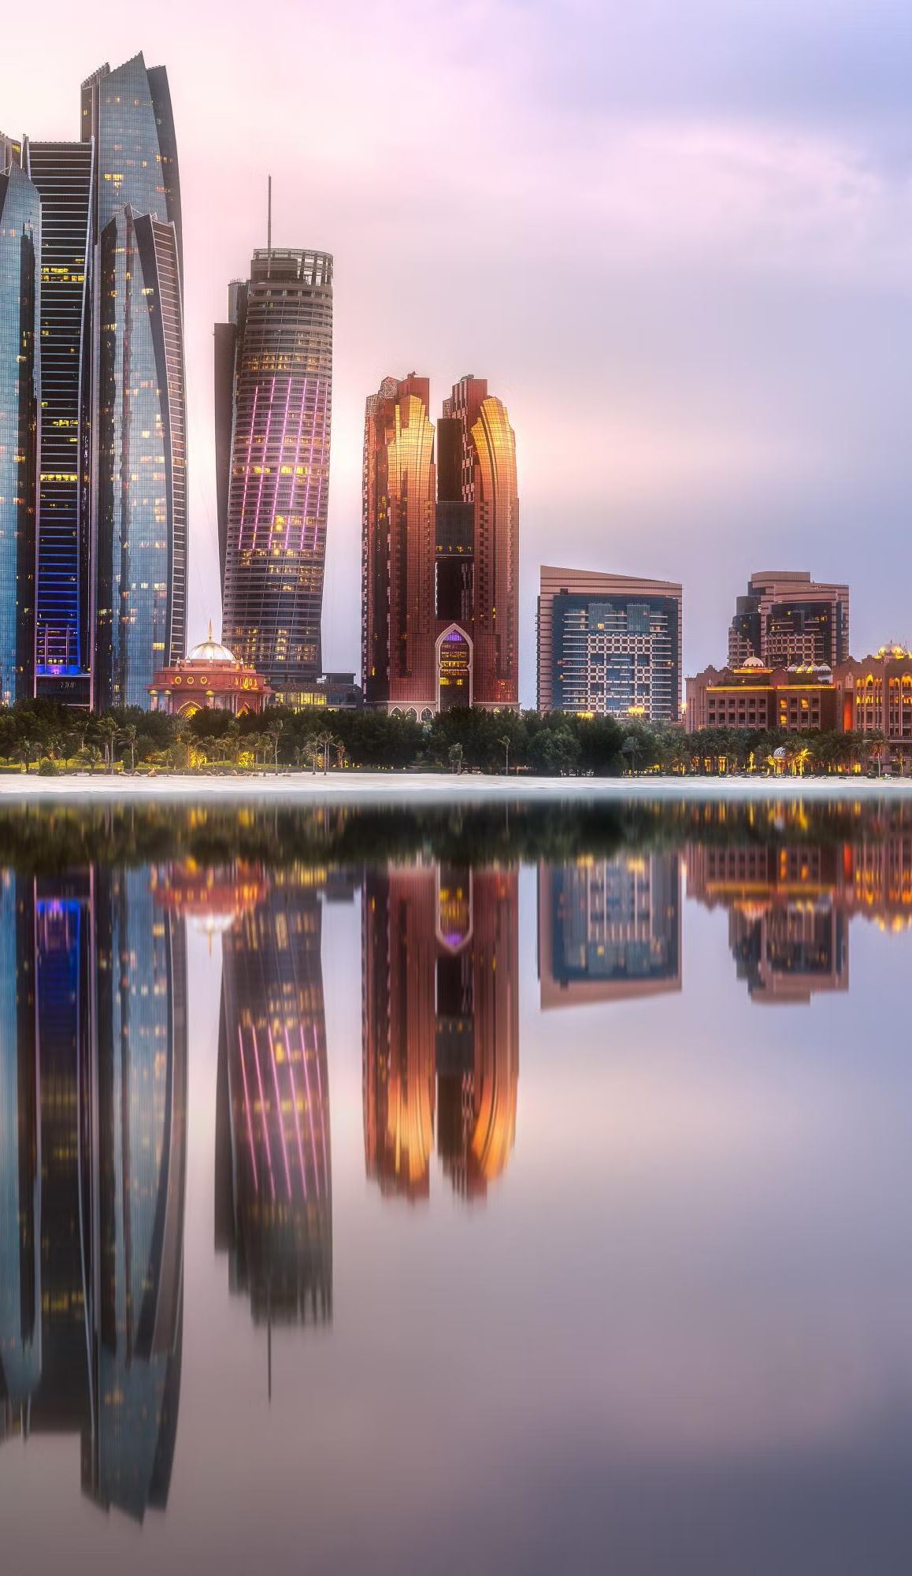
UAE 기후적, 인구적 특성
🌡️ Weather & Temperature
극한 기후 환경
하절기: 40-50°C (사막 지역 최대 55°C)
동절기: 15-25°C (상대적으로 온화)
습도: 연평균 60-80% (연안 지역 높음)
강수량: 연간 100mm 미만 (매우 건조)
식품 보관의 Challenge
고온으로 인한 빠른 부패: 신선식품 유통기한 단축
24시간 냉장 필수: 전력 효율성이 생존 조건
온도 변화: 실외-실내 온도차 30°C+ → 응결 문제
모래폭풍: 장비 보호 및 유지보수 복잡성
🙋 Human Source
극한 기후 환경
하절기: 40-50°C (사막 지역 최대 55°C)
동절기: 15-25°C (상대적으로 온화)
습도: 연평균 60-80% (연안 지역 높음)
강수량: 연간 100mm 미만 (매우 건조)
식품 보관의 Challenge
고온으로 인한 빠른 부패: 신선식품 유통기한 단축
24시간 냉장 필수: 전력 효율성이 생존 조건
온도 변화: 실외-실내 온도차 30°C+ → 응결 문제
모래폭풍: 장비 보호 및 유지보수 복잡성

Slide 14
Vending Machine Market Analysis

Slide 15
LAB TO MARKET

